Slide 1

The Next Great Divergence: How AI could split the world again if we don’t intervene
Week of March 22
Jacob Appling

Slide 2
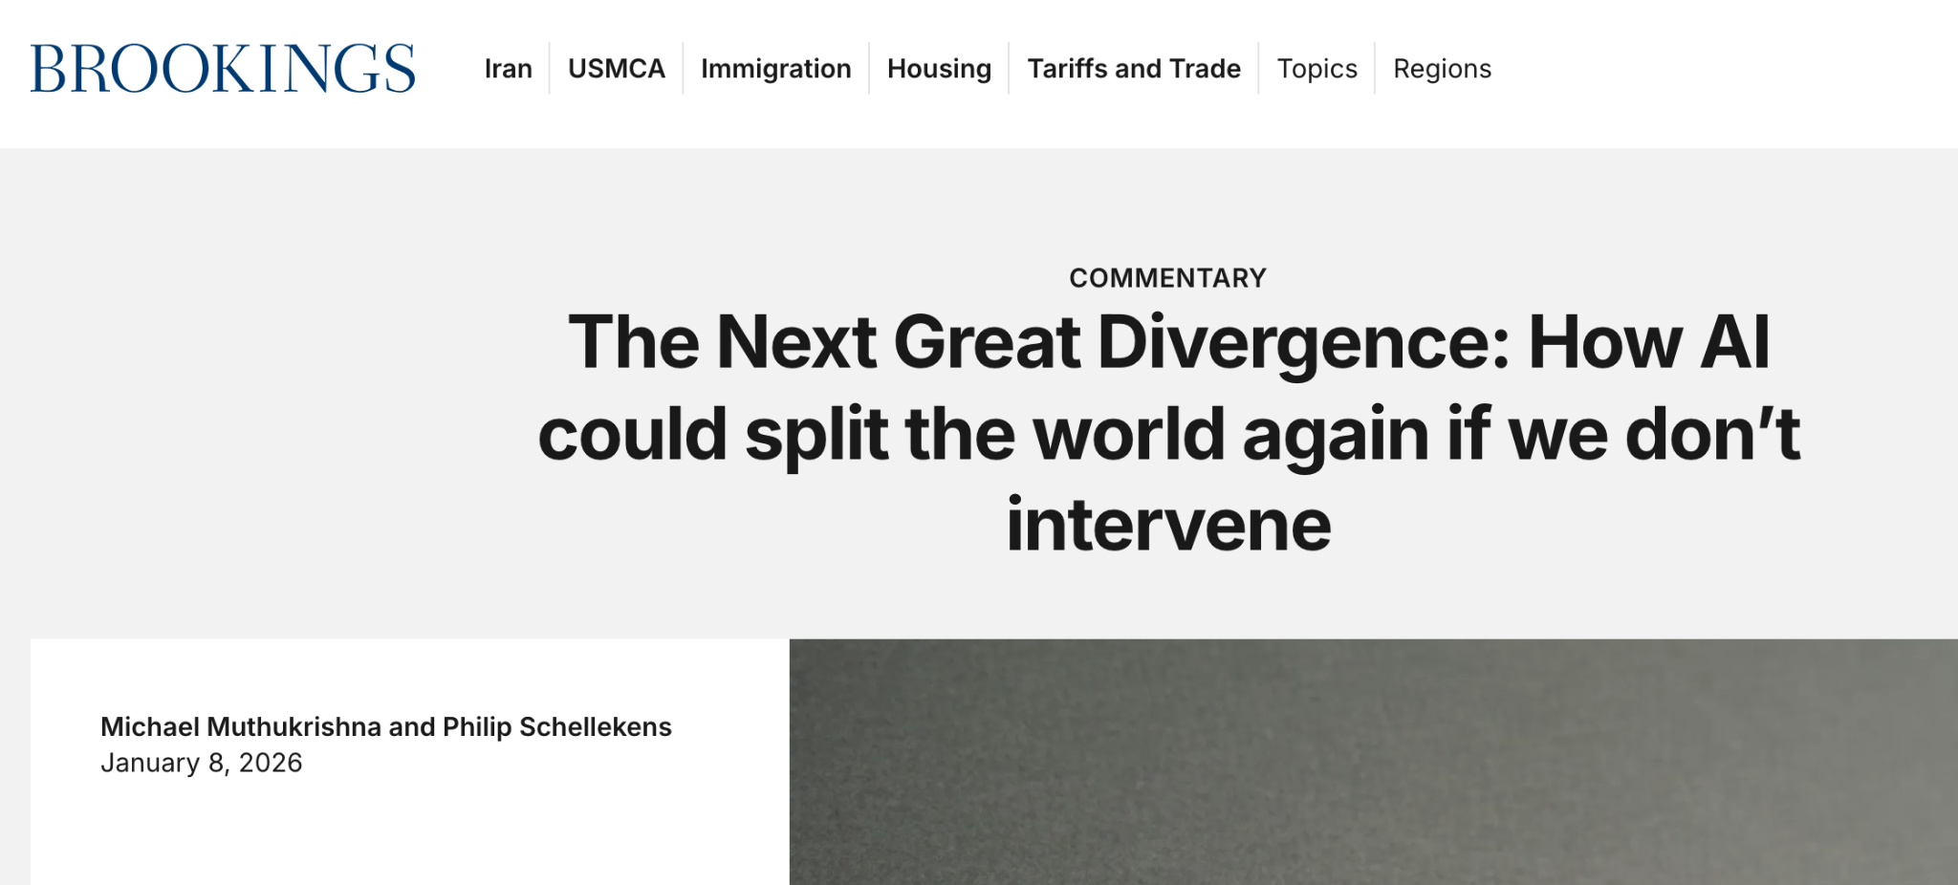
Article #4 (Row 4 via Google Sheet)

Slide 3
Link to the Source
https://www.brookings.edu/articles/next-great-divergence-how-ai-could-split-the-world/?utm_source=chatgpt.com

Slide 4
Main Findings
The article argues that artificial intelligence could become a transformative general-purpose technology, much like the steam engine during the Industrial Revolution, but with the potential to widen inequality between countries instead of reducing it. The author compares this risk to a possible “Next Great Divergence,” where the nations best prepared for AI capture most of the benefits while less-prepared countries bear more of the disruption.
A major point is that AI is not entering an equal world. Wealthier countries already have stronger digital infrastructure, more AI firms, more patents, and better education systems, which gives them a large advantage. Meanwhile, many lower-income countries still lack reliable internet, electricity, and digital skills, making it difficult for them to participate fully in the AI economy.
The article also emphasizes a second divide: vulnerability. Certain groups and countries are more exposed to AI’s downsides, including job displacement, reduced entry-level opportunities for younger workers, gender inequality in access to technology, and growing environmental strain from the energy demands of data centers.
To address these risks, the article recommends three main strategies: invest in human skills and institutions instead of only technology, develop regional AI public goods such as shared compute and local-language models, and create AI roadmaps tailored to each country’s level of readiness.

Slide 5
Broader implications for society
The broader societal implication is that AI could either improve lives on a massive scale or deepen existing inequalities. If implemented carefully, AI could expand access to education, improve healthcare, and raise productivity. But without deliberate planning, it may instead concentrate wealth, knowledge, and power in already-advantaged countries and communities.
The article also suggests that AI is not just a technical issue but a social and political one. Who gets access to AI tools, training, infrastructure, and governance will shape future opportunities. This means society must think beyond whether AI is “good” or “bad” and focus more on where it is being deployed, who benefits, and who gets left behind.
Another important implication is sustainability. AI’s growing energy demand could create environmental costs, especially in countries with weaker infrastructure or fossil-fuel-based power systems. That means AI development could increase pressure on already fragile systems unless governments make sustainability part of their planning.

Slide 6
Relevance and potential influence on the construction industry
For the construction industry, the article is highly relevant because construction often reflects the same capability and vulnerability gaps discussed in the piece. Companies and regions with stronger digital tools, better-trained workers, and more investment in innovation will likely benefit more from AI through improved scheduling, safety monitoring, cost estimating, design coordination, and productivity. Smaller firms or regions with fewer resources could fall behind.
The article’s emphasis on human capital is especially important for construction. Simply introducing AI tools into a company will not guarantee success if employees are not trained to use them effectively. Construction firms would need to invest in workforce education, digital literacy, and implementation strategies so AI supports workers instead of becoming an unused or poorly understood technology.
It also connects to construction through infrastructure and sustainability. As AI increases demand for data centers, power systems, and digital networks, the construction industry may play a direct role in building and upgrading that infrastructure. At the same time, the article’s warning about energy use suggests construction professionals may increasingly need to focus on energy-efficient facilities, sustainable design, and resilient infrastructure tied to AI growth.

